Slide 1
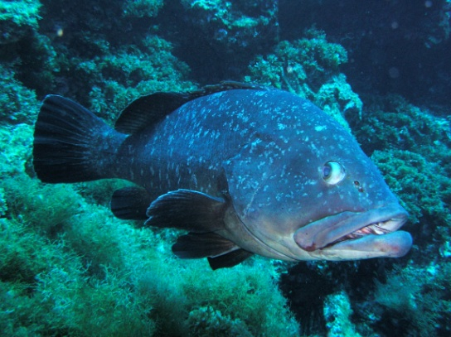
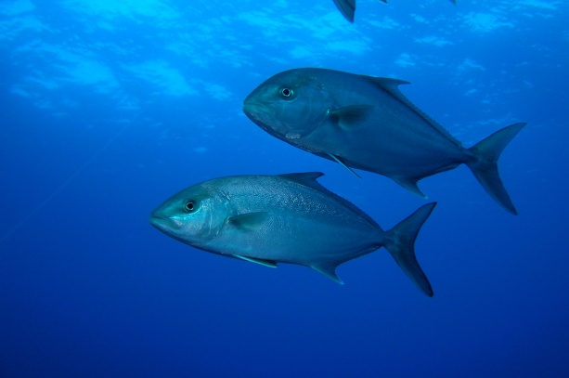
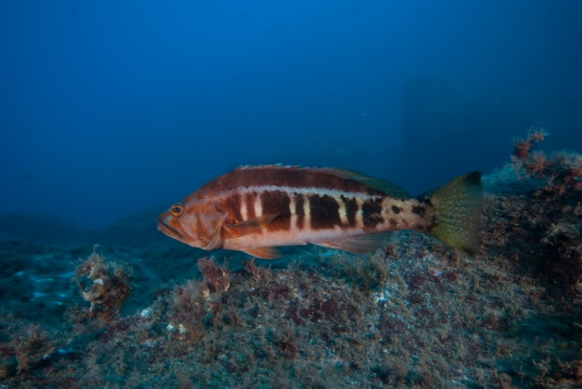
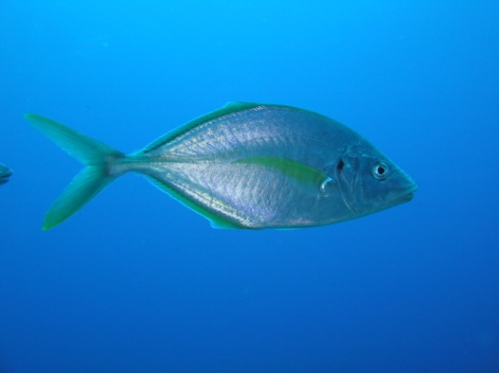
Movement ecology on temperate reef fishes: An ATT data collaboration
Steckenreuter, A.¹, Abecasis, D.², Fontes, J.^{1,3}, Erzini, K.², Afonso, P.^{1,3},
¹ Institute of Marine Research at the University of the Azores (IMAR-UAz), Department of Oceanography and Fisheries, Portugal
² Centre of Marine Sciences (CCMAR),University of the Algarve, Portugal
³ Marine and Environmental Sciences Centre (MARE), University of the Azores, Department of Oceanography and Fisheries, Portugal
IODE/OBIS-Event-Data Workshop on Animal Tagging & Tracking (ATT), Oostende, Belgium, April 2018

Slide 2
Research question: What affects space use?
(1) Habitat mode
Are pelagic species more vagrant and benthic species more site attached?
Do pelagic species use larger areas?
(2) Trophic level
Are herbivores more site attached?
Do piscivores have larger home ranges?
(3) Reproduction
Influence of spawning migrations and aggregations?
Do maximum range/home range change during reproduction cycles?
Increased residency during certain events?
(4) Fish size
Do larger fish have a larger home range?
Are smaller fish more resident?

Slide 3
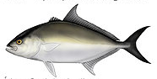
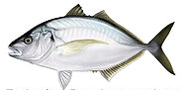
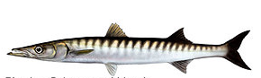
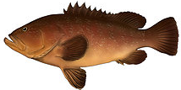
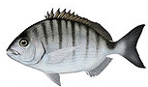
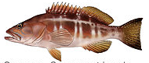

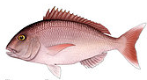
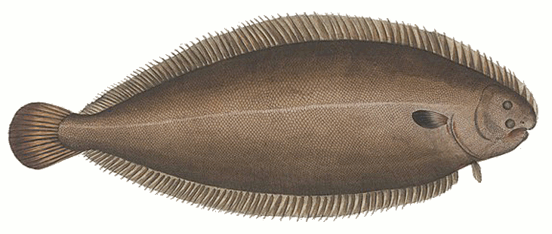
Study species
Sphyraena viridensis
Seriola rivoliana
Pseudocaranx dentex
Epinephelus marginatus
Serranus atricauda
Diplodus sargus
Solea senegalensis
Sparisoma cretense
Pagrus pargus
Notes:
Yellowmouth barracuda; Almaco jack; white trevally; dusky grouper; blacktail comber; White seabream; Senegalese sole; Mediterranean parrotfish; Red porgy

Slide 4
Study species - Habitat
Pelagic
Sphyraena viridensis
Seriola rivoliana
Pseudocaranx dentex
Benthic
Bentho-pelagic
Epinephelus marginatus
Serranus atricauda
Diplodus sargus
Solea senegalensis
Sparisoma cretense
Pagrus pargus
Notes:
Yellowmouth barracuda; Almaco jack; white trevally; dusky grouper; blacktail comber; White seabream; Senegalese sole; Mediterranean parrotfish; Red porgy

Slide 5
Study species – Trophic Level
Omnivore
Piscivore
Sphyraena viridensis
Seriola rivoliana
Pseudocaranx dentex
Epinephelus marginatus
Serranus atricauda
Diplodus sargus
Molluscivore
Herbivore
Pagrus pargus
Solea senegalensis
Sparisoma cretense
Notes:
Adjust lines

Slide 6
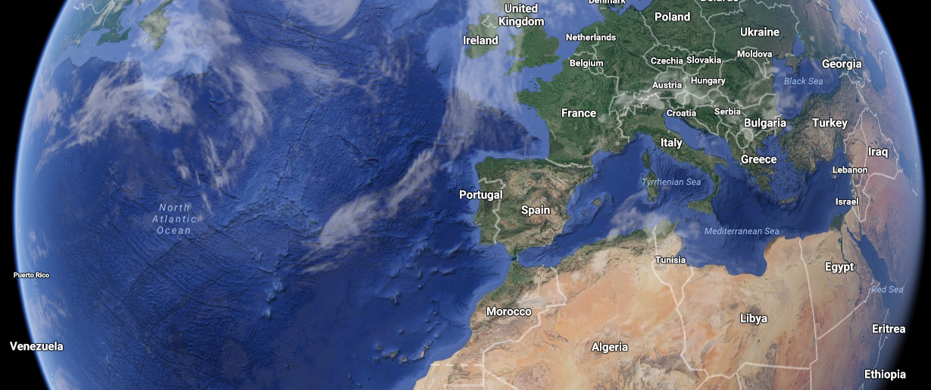
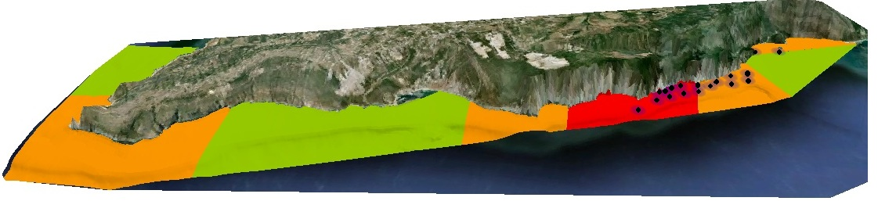
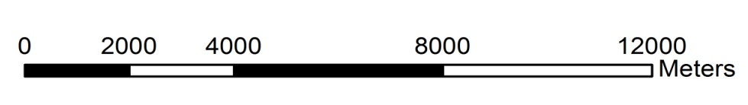
Study areas and tagged species
(1) Arrábida Marine Park
approx. 35 km south of Lisbon
White Seabream
n= 20
TL 20-37 cm
max 10 months (avg 5)
Senegalese Sole
n= 22
TL 30-41 cm
max 10 months (avg 4)

Slide 7
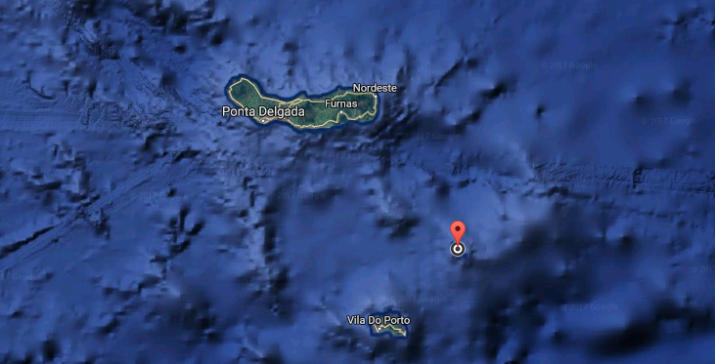
Study areas
Study areas and tagged species
(2) Azores, São Miguel
Offshore seamount Formigas approx. 60 km SE
Yellow Barracuda
n= 17
TL 65-104 cm
max 4 years (avg 2.4)
Almaco Jack
n= 16
TL 53-118 cm
max 4.1 year (avg 3.8)

Slide 8
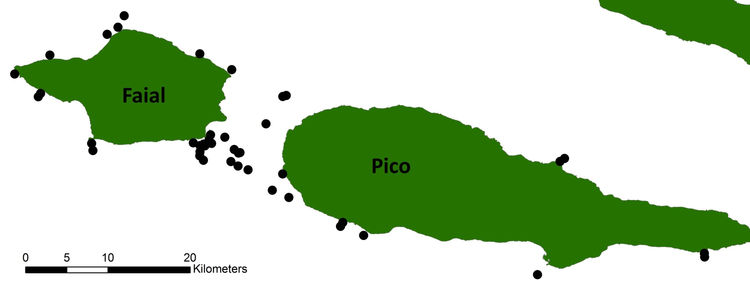
Study areas
Study areas and tagged species
(3) Azores, Faial-Pico
Coastal area
Red Porgy
n= 22
TL 21-42 cm
4.5 years (avg 1.6)
Med. Parrotfish
n= 10
TL 31-48 cm
5 years (avg 2)
Blacktail Comber
n= 9
TL 27-40 cm
3 years (avg 1.8)
Dusky Grouper
n= 12
TL 37-93 cm
6 years (avg 4)
White trevally
n= 32
TL 34-71 cm
5 years (avg 1.6)
Notes:
Add names

Slide 9
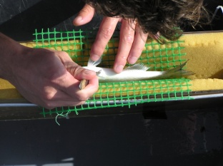
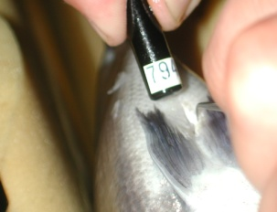
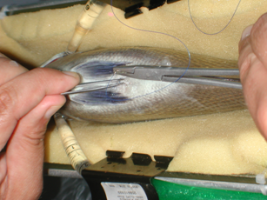
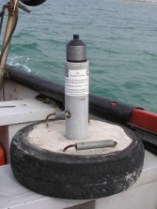
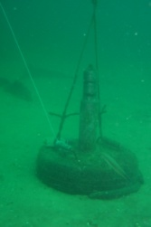
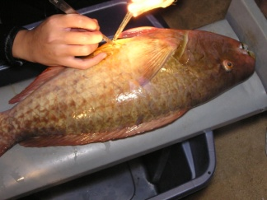
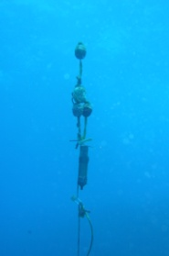
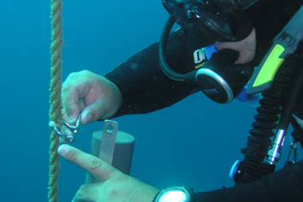
Materials and Methods
Acoustic telemetry equipment
VR2 and VR2W acoustic receivers
V7, V9 and V13 acoustic transmitters
Estimated metrics
Home range and core areas based on KUD (95% and 50%)
Residency index
Maximum distance between receivers with detections

Slide 10
Results – Habitat – Example Home Range
ANOVA on ranks (data not normally distributed even after transformation) indicated significant difference between groups
Post-hoc Dunn’s Method indicated significant differences between pelagic fish and all others
Pelagic
Bentho-pelagic
Benthic
Notes:
ANOVA on ranks (data not normal even after transformation) indicated a significant difference between groups. Dunn’s method showed significant differences between pelagic and the other 2 groups (bentho-pelagic and benthic)

Slide 11
Results – Trophic Level – Example Max. Range
Individual data not normally distributed
ANOVA & Dunn’s Method indicated significant differences between Omnivore/Herbivore and Piscivore/Herbivore
Piscivore
Molluscivore
Omnivore
Herbivore
Notes:
Individual data (not normal so anova on ranks and Dunn test)
Omnivore vs Herbivore 61.306 4.595 Yes
Omnivore vs Molluscivore 26.332 2.476 No
Omnivore vs Piscivore 18.323 2.219 Do Not Test
Piscivore vs Herbivore 42.983 3.000 Yes
Piscivore vs Molluscivore 8.010 0.676 Do Not Test
Molluscivore vs Herbivore 34.974 2.211 No

Slide 12
Results – Reproductive Status: Spawning vs Resting Period
Wilcoxon Signed Rank Test
Species | Home range | Core area | Maximum range | Residency
 | > During spawning | X | X | X
 | X | X | X | > During spawning
 | X | X | > During spawning | X
 | X | X | > During spawning | X
 | X | X | > During resting | X
 | X | X | X | X
 | X | X | X | X
 | X | X | X | X
 | X | X | X | X

Slide 13
Results – Fish Size – Example Residency
Spearman’s Rank Correlation
Larger individuals are less resident

Slide 14
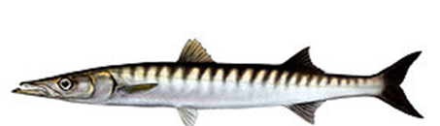
Data Storage
Currently, data is stored locally
In the future, data will be stored as part of the European Telemetry Network’s data
management platform (http://www.lifewatch.be/etn/)
⇨ This may foster collaborations of this sort more widely
Notes:
Trophic level seems to influence space use but this need to be further developed in order to provide stronger and clearer conclusions
Preying mode -> piscivores ambush predators vs stalking predators

Slide 15

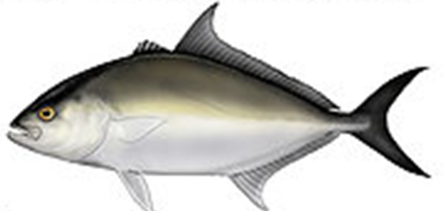



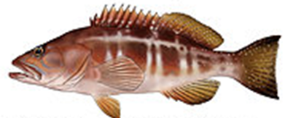

Questions?
astecken@gmail.com

